Slide 1

MEDI-CAPS UNIVERSITY, INDORE
Department of Information Technology Engineering
PROJECT - FAKE NEWS DETECTION
Group Members:- Under The Guidance of :-
1. Sheikh Mohammed Sajid (EN17IT301090) Mr. Sourabh Bhat
2. Sohan Khedekar (EN17IT301098)
3. Sumit Sen (EN17IT301102)

Slide 2
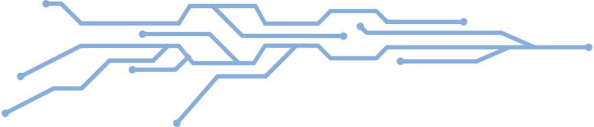
OUTLINE OF THE PRESENTATION
Project Objective
Background Work
Feature of Project
No. of Modules
Diagrams
Future Scope
Limitation

Slide 3
PROJECT OBJECTIVE
In this project following objectives have been focused on:
To find the relation in the words and the context in which the words appear within the text and how it could be used to classify texts as real (negative cases) or fake (positive).
To determine which classification algorithm is appropriate in predicting the reality of a given news article.
To provide a simple and interactive user interface which can classify user given news article into fake or real news
1

Slide 4
BACKGROUND WORK
REQUIREMENTS :-
Python : Python is an interpreted, high-level and general-purpose programming language.
Numpy : NumPy is a library for the Python programming language, adding support for large, multi-dimensional arrays and matrices, along with a large collection of high-level mathematical functions to operate on these arrays.
Pandas : pandas is a fast, powerful, flexible and easy to use open source data analysis and manipulation tool, built on top of the Python programming language.
2

Slide 5
Matplotlib : Matplotlib is a comprehensive library for creating static, animated, and interactive visualizations in Python.
Sklearn : Scikit-learn is a free software machine learning library for the Python programming language.
Pickel: Python pickle module is used for serializing and de-serializing python object structures.
Flask: Flask is a web application framework written in Python. Flask is based on Werkzeug WSGI toolkit and Jinja2 template engine.
3

Slide 6
In this, a model is build based on the tf-idf matrix ( i.e. word tallies relatives to how often they are used in other artices in your dataset )
Since this problem is a kind of text classification, implementing a classification algorithm of Machine Learning will be best.
Classification is the process of recognizing, understanding, and grouping ideas and objects into preset categories. In context of fake news detection we have categorized any news article into “fake news” and “real news”.
Different classification algorithm used are Naïve Bayes, Logistic Regression, Decision Tree and Random Forest. Their accuracy is as follows:-
4

Slide 7
FEATURE OF PROJECT
Accuracy of the result: Our goal is to make a fake news detector with above 90% accuracy that uses machine learning.
Usability: The scope of the product is widespread. The only requirement is the input given as title, text and subject as a user. Besides, people from every age shall easily use the system.
Performance: We are aiming to make the system real-timed. In other words, the system should have enough speed that users of the system cannot realize the processing of data.
The system UI is very user friendly and contains a button which will execute the machine learning model on the basis of the input provided by the user.
5

Slide 8
NUMBER OF MODULES
MODULE 1 : Data Preprocessing
All the text is converted to lowercase , then removed the punctuation marks and stopwords
MODULE 2 : Data Visualization
With the help of bar plots and wordcloud data visualization is done.
MODULE 3 : Model Building
The modeling process will consist of vectorizing the corpus stored in the “text” column, and finally classification machine learning algorithm will be applied. Model with highest accuracy will be selected.
MODULE 4 : Model Deployment
With Flask and HTML , CSS , Bootstrap the model is deployed in a user friendly way. So that user can easily use the ML model.
6

Slide 9
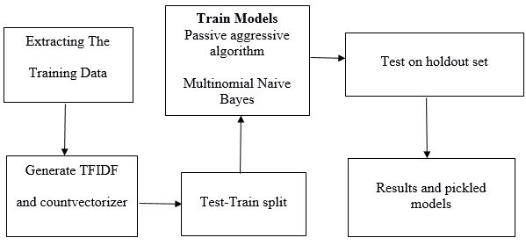
DIAGRAMS
Fig 1.1 Flow of Implementation of Project
7

Slide 10
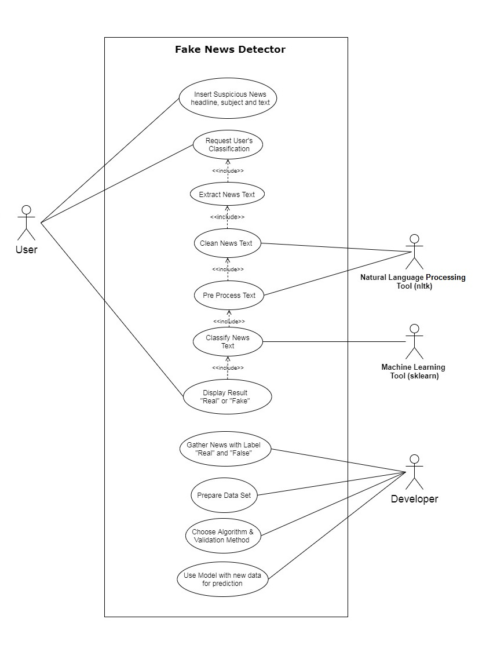
Fig 1.2 Use Case Diagram of Project
8

Slide 11
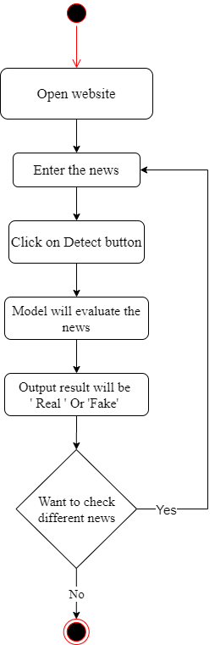
Fig 1.3 Activity Diagram of Project
9

Slide 12
FUTURE SCOPE
To identify possible sources of fake news.
To remove/detect malicious accounts that spread fake news.
Will be helpful for Cyber Crime Bureau.
For further research purpose.
To identify patterns of fake news on social media sites
Study the lifecycle of fake news.
10

Slide 13
LIMITATIONS
The dataset should be updated regularly with every new news article.
Very old news can’t be determined whether they are real or fake.
11

Slide 14
THANK YOU

